Slide 1
Infection Control
Helping Restore Ability
Notes:
We will input where to reference this in the policy handbook/have copies of this section available to attendants.

Slide 2
Course Description
In this training we will go over how to minimize you, your coworkers and your client's exposure to infection.
Based on our policies and procedures manual

Slide 3
Instructor Contact Information
Office Phone:
817-823-6759
Office Hours:
Mon-Thurs. 8-5
Friday 8-4
Care Team Manager
HR Manager
Notes:
This directs them to donna and I’s office phone but can be edited if neede

Slide 4
Materials
Books
HRA Policies/Procedures Handbook
Websites
https://www.cdc.gov/handwashing/when-how-handwashing.html#:~:text=Wet%20your%20hands%20with%20clean,for%20at%20least%2020%20seconds.
https://www.globus.co.uk/how-to-safely-remove-disposable-gloves
https://coronavirus.dc.gov/page/what-covid-19
Videos
://www.youtube.com/watch?v=E0uuXr_Axcs
https://youtu.be/zNV6dK6Y-Ek

Slide 5
Course Objectives
Course Objectives | Skills Developed
1-Discuss commonly used terms | Recognize commonly used terms
2-Bloodborne/airborne pathogens | Identify differences between bloodborne/airborne pathogens
3-COVID- 19 | Identify symptoms and precautions used when referring to COVID-19
4-Hand Hygiene | Display proper hand hygiene
5-PPE to wear | Choosing proper PPE to wear in certain situations
6-Donning/doffing PPE | Display proper usage of PPE and applying correctly

Slide 6
Section 1- General Terms
Bacteria- Living organism that can live on surfaces and inside the human body. Bacteria does not need a host to survive.
Virus- Nonliving organisms that effect all life forms, from humans, to animals, to plants. Viruses must have a host to survive.
Immune system- Bodies defense system that helps fight against infection/disease, bacteria, and viruses.
Sterile- Free of bacteria, viruses and other harmful microorganisms.

Slide 7
Cleaning in the Home
Clean client's home with good disinfectants
Bleach solution, Lysol, Clorox
Clean any medical supplies in the bathroom, then clean the bathroom last
Wear gloves when using disinfectant cleaners

Slide 8
Types of Contact/Spread
Direct Contact- infection spread by skin-skin contact or droplet-skin contact.
Indirect Contact- infection spread by air or other mechanisms.
Ex. airborne, contaminated objects, food/drinks
Vector Borne diseases- infection spread by animals or insects.

Slide 9
Section 2- Bloodborne/Airborne Pathogens
Airborne
Bloodborne
Germs spread through the air by someone who sneezes, coughs, or even talks.
Ex. SARS, Chicken Pox, Tuberculosis, Coronavirus
Germs spread through blood of a diseased person and can cause disease in humans.
Ex. HIV, HEP B., present on used needles/bandages

Slide 10
Avoiding Contact
Airborne Pathogens/COVID-19
Bloodborne Pathogens
Mask
Eye protection
Gloves
Should be worn if client shows symptoms of airborne disease
Gloves should be worn when client has a known blood carried disease
Should assume all blood/bodily fluids are infectious
Never touch objects contaminated with bodily fluid without gloves
Never recap needles
Notes:
Talk about coronavirus precautions
Placing needles in biohazard containers

Slide 11
Section 3-COVID-19 (Coronavirus Outbreak)
Coronaviruses are a large family of viruses that can cause anything from the common cold to more severe diseases such as SARS and Middle East Respiratory Syndrome (MERS).
COVID-19 is a new strain of coronavirus mainly causing respiratory illness and outbreak.
Symptoms Include :
Cough
Fever
Headache
New loss of taste or smell
Repeated shaking with chills
Sore throat
Shortness of breath
Muscle pain

Slide 12
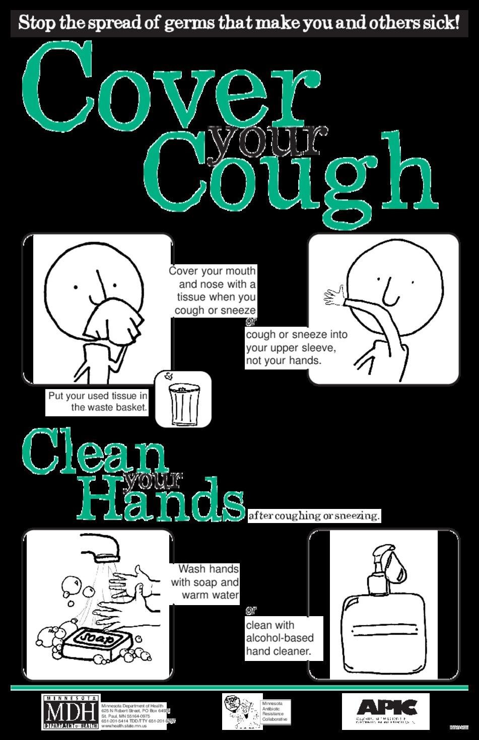
COVID-19 Guidelines
Avoid touching face
Social distancing (as much as possible)
Although this is difficult when doing client care we encourage it as much as possible. If you must be in close quarters with someone insure you have all PPE necessary for the protection of you and your client.
Cough etiquette
Pre-screen yourself and your client before every visit
If you or your client have any symptoms, contact supervisor immediately
Notes:
This is a time to remember social distancing in ones personal life as well. Clients we care for are often immune compromised and it is important we protect them as much as possible.
Prescreening is asking questions of symptoms and taking tempurture of yourself and client
Supervisor is _____

Slide 13
Use all the following precautions when dealing with possible COVID-19 Clients
Refer to HRA Policy handbook

Slide 14
Section 4- Hand Hygiene
Washing hands regularly with antiseptic soap
Washing hands / sanitizing before and after gloves are worn
Using Alcohol-based hand sanitizer when washing hands isn't available
General Rule- If it's wet, wear gloves!
Use new gloves for each procedure and use them only once! Don't reuse disposable gloves.
Notes:
Wet your hands with clean, running water (warm or cold), and apply soap. Lather your hands by rubbing them together with the soap. Lather the palms, backs of hands, between your fingers, and under your nails. Scrub your for at least 20 seconds.

Slide 15
Section 5- PPE to Wear
Gloves
ALWAYS when doing: Routine personal care (bathing, dressing toileting, assisting with medication, oral hygiene, grooming, skin/nail care, transferring), cleaning
Mask
Always while in client’s home
Goggles/Eye Protection
When in close contact with client who has signs of airborne disease
Client has signs/ symptoms of coronavirus/TB/other respiratory disease
Notes:
Talk about procedures during Covid-19 outbreak
Routine personal care- Bathing, dressing toileting, assisting with medication, oral hygiene, grooming, skin/nail care, transferring

Slide 16
Section 6-Donning/Doffing PPE

Slide 17
Gloves
1. Pinch and hold the outside of the glove near the wrist area.
2. Peel downwards, away from the wrist, turning the glove inside out.
3. Pull the glove away until it is removed from the hand and hold the inside-out glove with the gloved hand.
4. With your un-gloved hand, slide your finger/s under the wrist of the remaining glove, taking care not to touch the outside of the glove.
5. Again, peel downwards, away from the wrist, turning the glove inside out.
6. Continue to pull the glove down and over the inside-out glove being held in your gloved hand.
This will ensure that both gloves are inside out, one glove enveloped inside the other, with no contaminant on the bare hands.

Slide 18
Mask (Surgical)
1. Position the colored side of the mask outward.
2. If present, make sure the metallic strip is at the top of the mask and positioned against the bridge of your nose.
3. If the mask has:
Ear loops: Hold the mask by both ear loops and place one loop over each ear.
Ties: Hold the mask by the upper strings. Tie the upper strings in a secure bow near the crown of your head. Tie the bottom strings securely in a bow near the nape of your neck.
4. Mold the bendable metallic upper strip to the shape of your nose by pinching and pressing down on it with your fingers.
5. Pull the bottom of the mask over your mouth and chin.
6. Be sure the mask fits snugly.
Don’t touch the mask once in position.
If the mask gets soiled or damp, replace it with a new one.
Check for defects in the face mask, such as tears or broken loops.
://www.youtube.com/watch?v=E0uuXr_Axcs
Notes:
Refer to policy on our reusing mask/storing procedures

Slide 19
Masks (N95 Respirators)
1. Hold the respirator in the palm of your hand with the straps facing the floor.
2. Place the N95 respirator on your face covering your nose and mouth.
3. Pull the bottom strap up and over top of your head and put it behind your head below your ears.
4. Take the upper strap and put it behind your head towards the crown of your head.
5. Mold the nose piece of the respirator over the bridge of your nose to obtain a tight seal.
Perform a fit check to ensure there is a good seal against the skin.
https://youtu.be/zNV6dK6Y-Ek

Slide 20
If you are sick
Must report immediately to supervisor at the first sign/symptom of illness so that appropriate arrangements can be made for your client
Before returning to work after being off due to an infectious or communicable disease, contact your supervisor to clear you for your duties.

